Slide 1
Introduction to GIS And QGIS

Slide 2



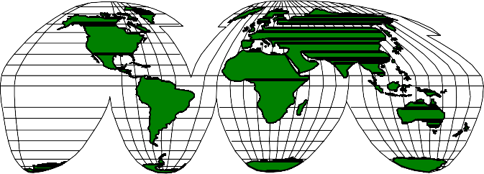
What is a GIS?
Information System
A means of storing, retrieving, sorting, and comparing
spatial data
to support some analytic process.
+
Geographic Position

Slide 3
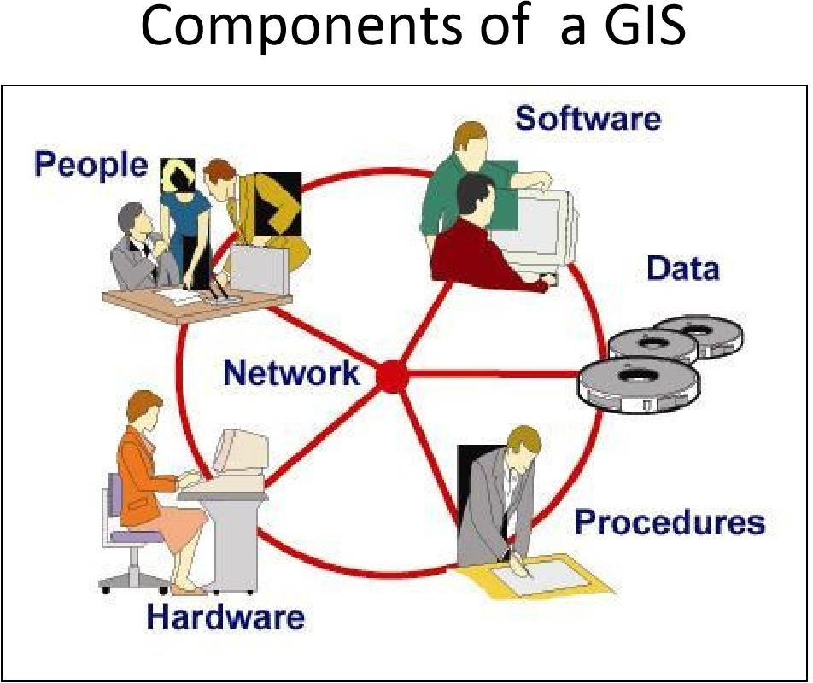
3

Slide 4












Geographic Information System
Define problem
Decision
GIS
Process
Define GIS criteria
Output
GIS
analysis
Import or build datasets

Slide 5
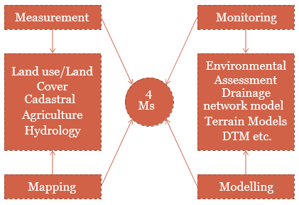
4Ms of GIS
5

Slide 6
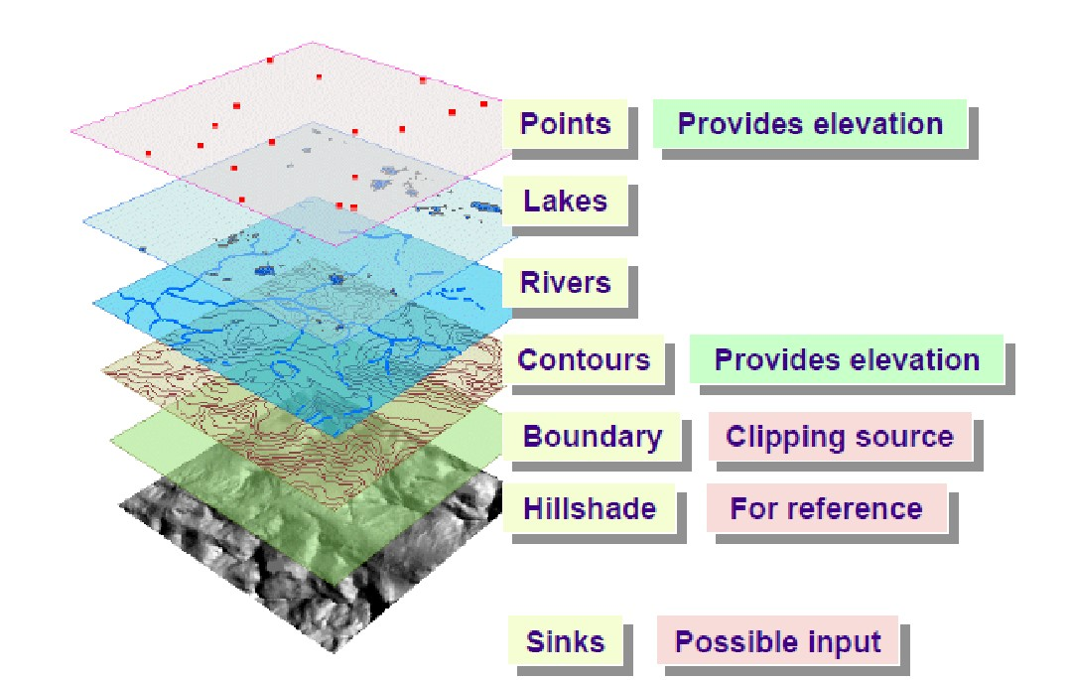
Dhwanilnath Gharekhan
6

Slide 7
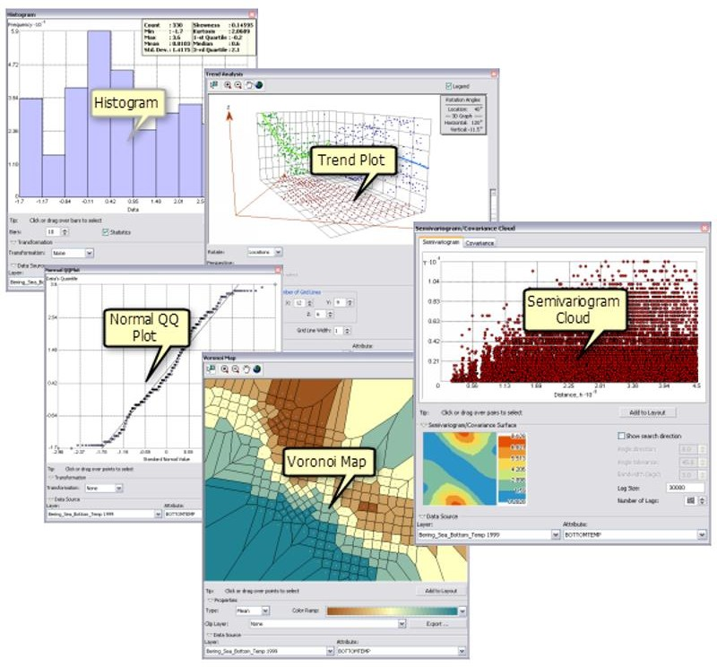
7

Slide 8
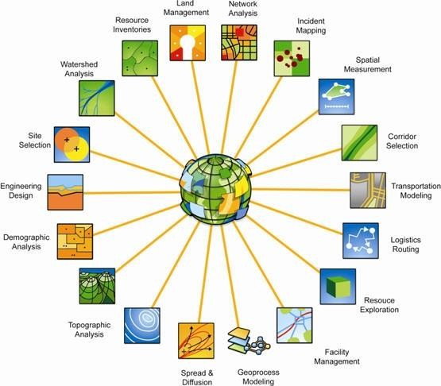
Application of GIS
8

Slide 9

Introduction to QGIS
Quantum GIS
Open and Free to Use Community Driven Software
QGIS is a professional GIS application that is built on top of and proud to be itself Free and Open Source Software (FOSS).
9

Slide 10
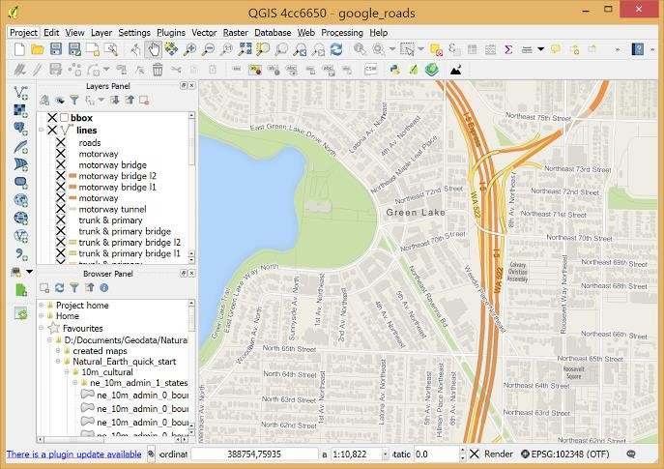
Applications - Usage
DOWNLOAD
https://qgis.org/en/site/forusers/download.ht ml
RECOMMENDED VERSIONS:
v 3.10 (stable)
v 3.14 (latest)
v 2.x (if the above two don’t function on your
system)
ADD-ONS
Python 2.7 (needs to installed to use QGIS) https://www.python.org/download/releases/2
.7/
https://www.qgis.org/en/_static/images/about-screenshot.png
10

Slide 11
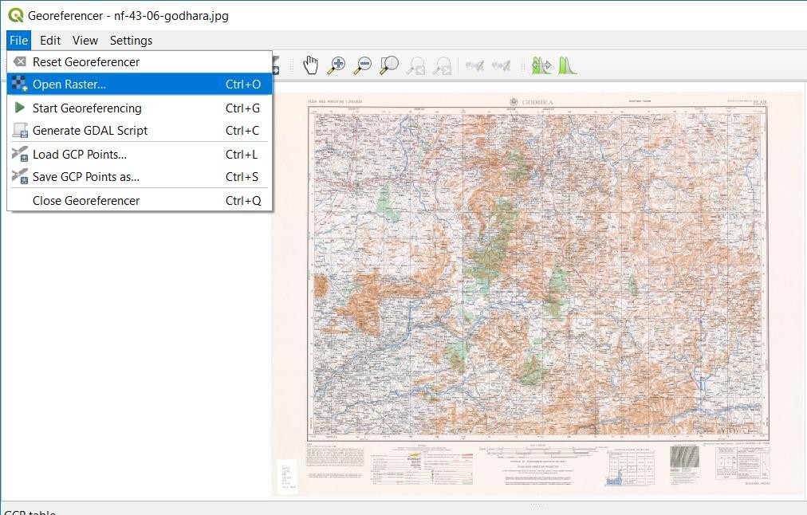
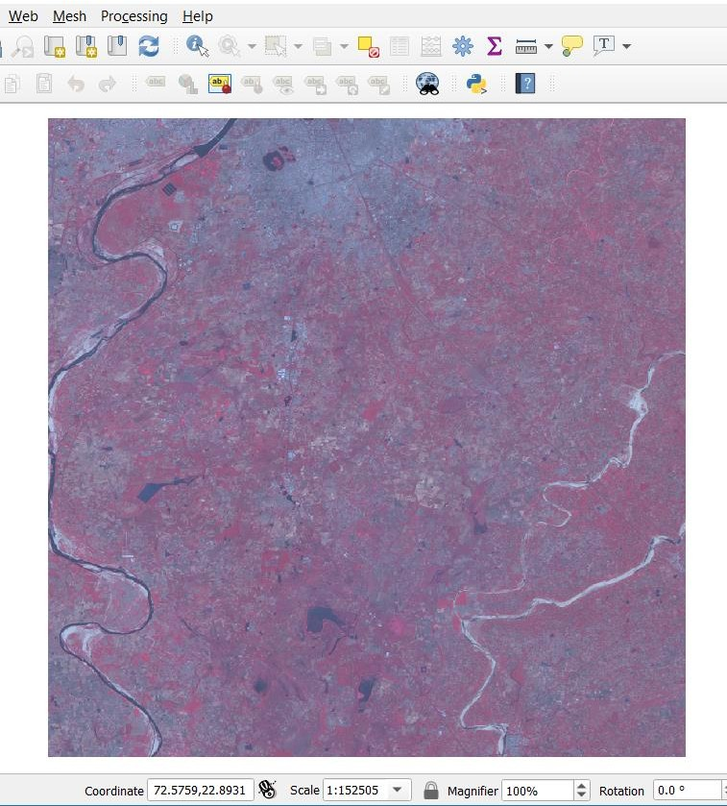
Practical Brief
Image Registration
Layer Stacking and Mosaicking
12

Slide 12
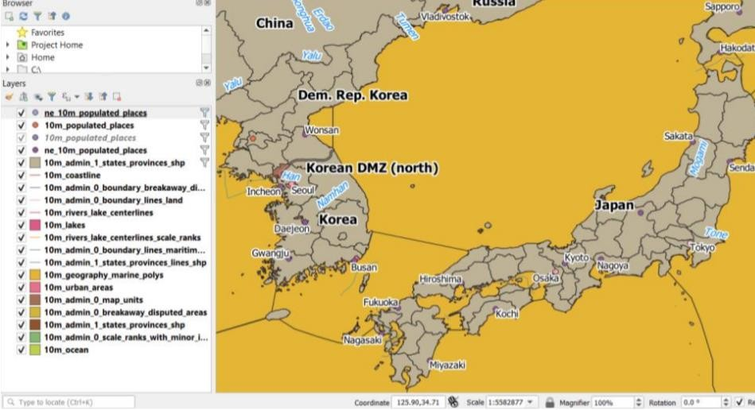
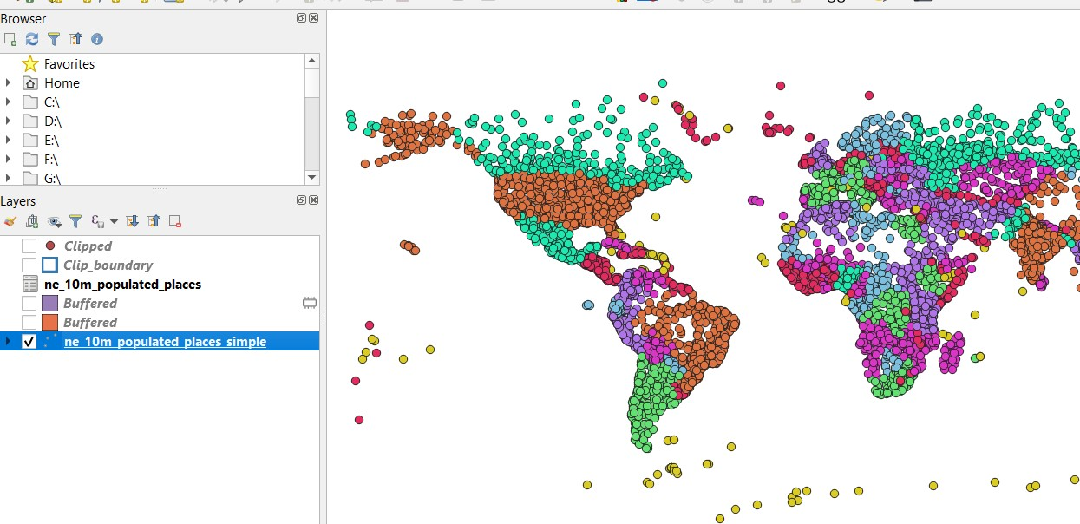
Practical Brief
Digitization
Vector Statistics
13

Slide 13
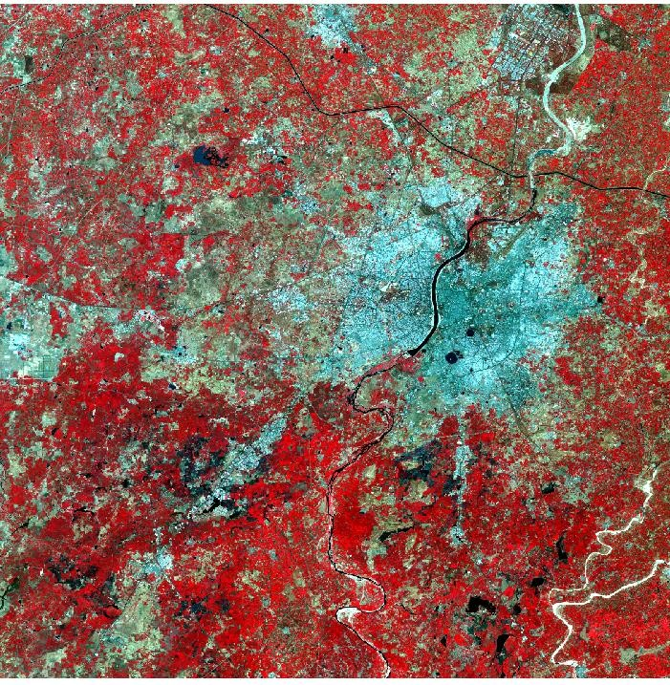
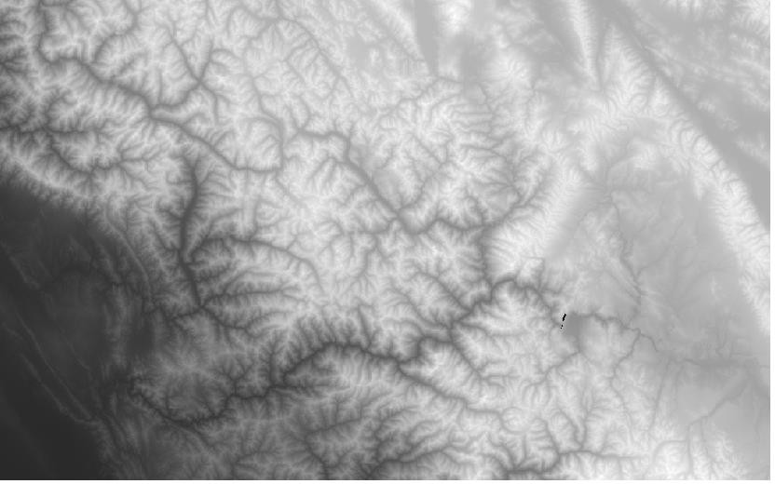
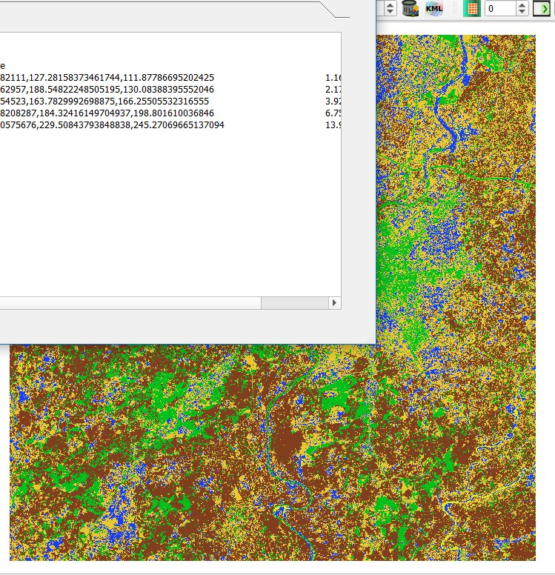
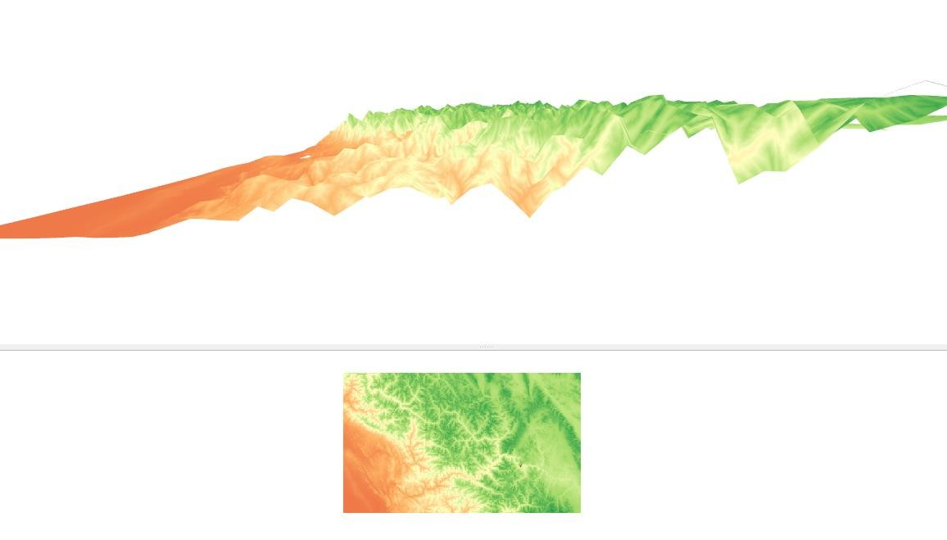
Practical Brief
Classification
DEM
14

Slide 14
Thank You
Any Questions????
16

